Slide 2

Lebanese University
Faculty of Engineering III, Hadath
Classification of QRS complexes of ECG traces
Prepared by: Karim Sleiman
Supervised by: Dr. Youssef Harkouss
Jury Members:
Dr. Mohamad Aoudé
Dr. Mazen Ghandour
Dr. Youssef Harkouss

Slide 3
Project Plan
01
02
03
Introduction
Chapter I
Chapter II
04
05
Chapter III
Conclusion
The heart muscle
Classification of QRS complexes
Simulation of ECG signals

Slide 4
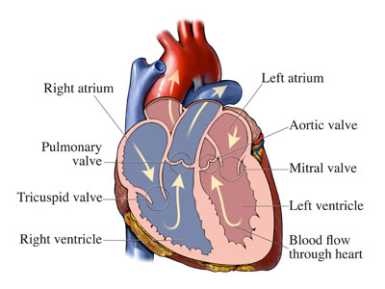
Introduction

Slide 5
Chapter I THE HEART MUSCLE

Slide 6
I:1
Cardiac Cycle & Action Potential

Slide 7
Cardiac Cycle

Slide 8
Cardiac Action Potential
Pacemaker Cell
Myocyte Cell

Slide 9
I:2
Cardiac Conduction

Slide 10
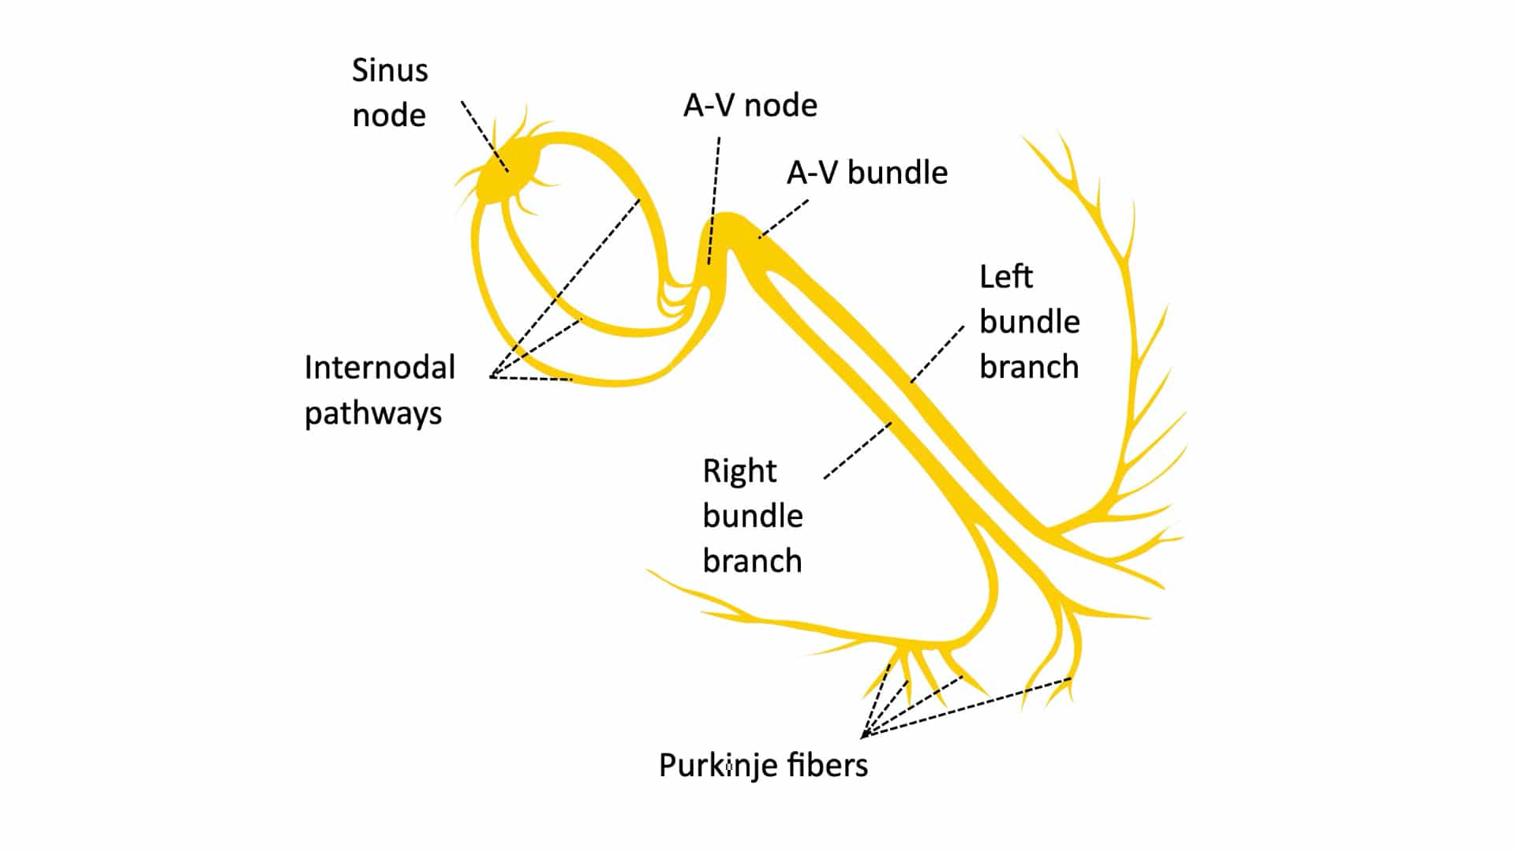
Normal Conduction

Slide 11
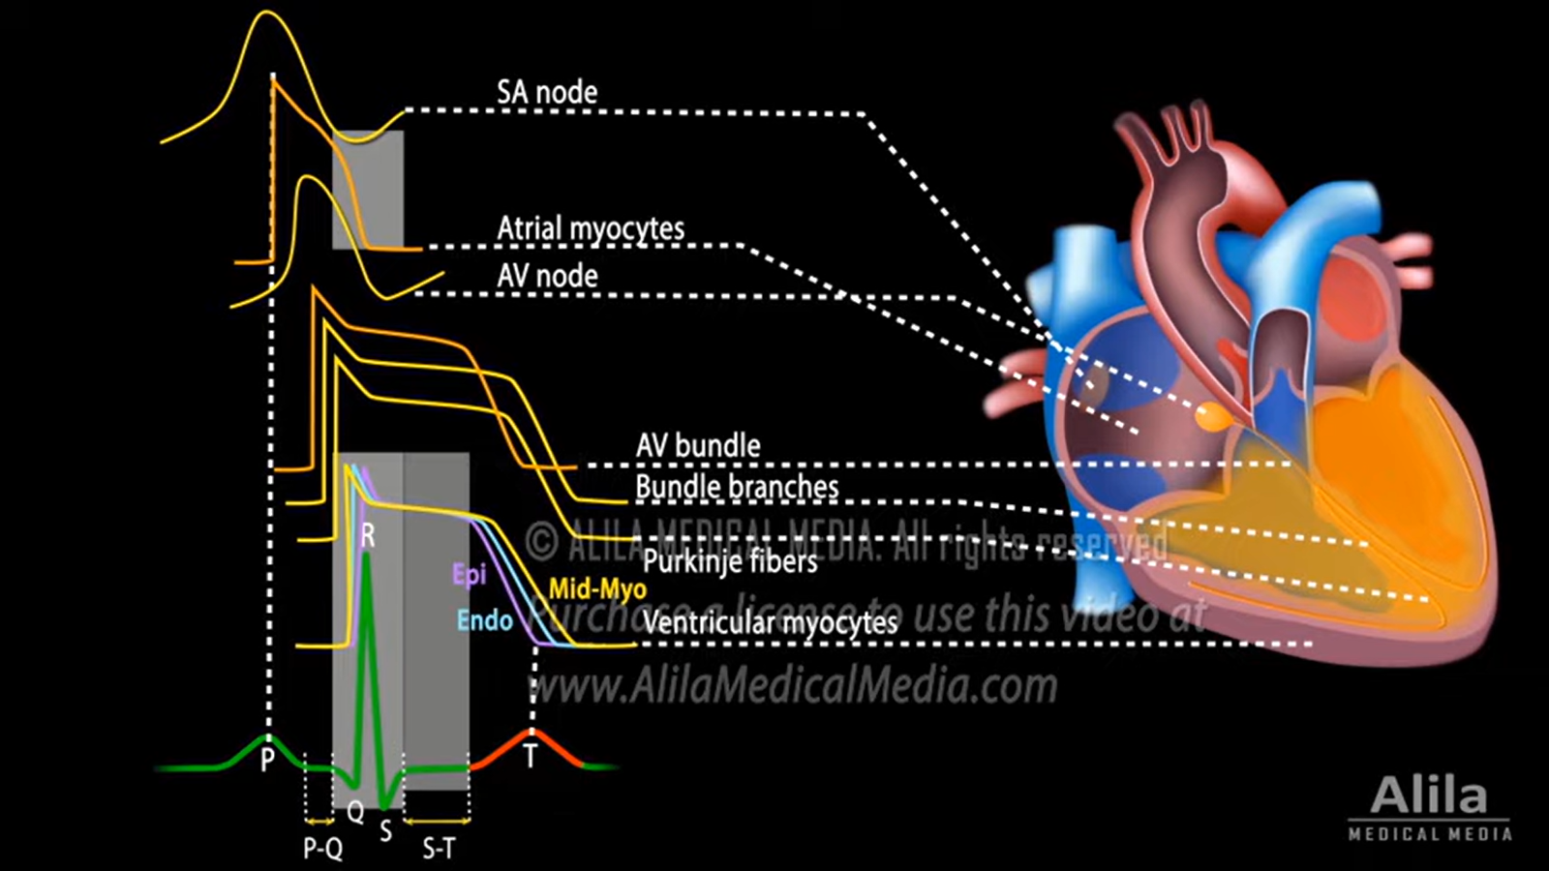
ECG: Sum of Action Potentials

Slide 12
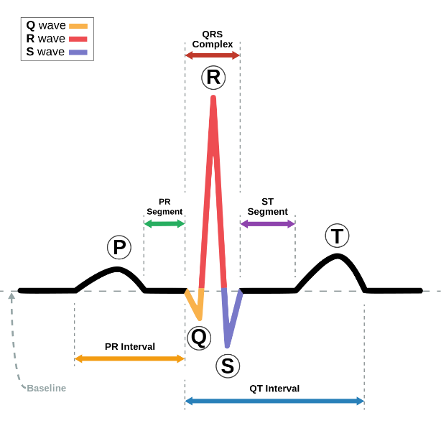
General ECG signal
P-wave: Atrium depolarized
P-Q segment: Conduction SA→AV
QRS complex: Ventricular depolarization
Q-wave: depolarization of interventricular septum
R-wave: depolarization of main mass of the ventricles
S-wave: depolarization of the lower region of the ventricles
S-T segment: plateau phase, Ventricle contraction
T-wave: Ventricular repolarization

Slide 13
I:3
How to read an ECG/EKG

Slide 14
12-Lead ECG

Slide 15
Understanding ECG
Heart rate
Heart rhythm
P-Wave
PR interval
QRS complex
ST segment
<100 & >60 beats per minute
Variations of QRS intervals is consistent
Regular Sinus Rhythm
Should not be longer that usual: AV Block
70-100ms wide QRS for regular Ventricular depolarization
Flat indicating the plateau phase

Slide 16
I:4
Cardiac Arrhythmias

Slide 17
Different Cardiac Arrhythmias
Sinus
Atrial
Ventricular
Sinus Bradychardia & Sinus Tachycardia
Possible cause of super ventricular arrhythmias
Most Dangerous

Slide 18
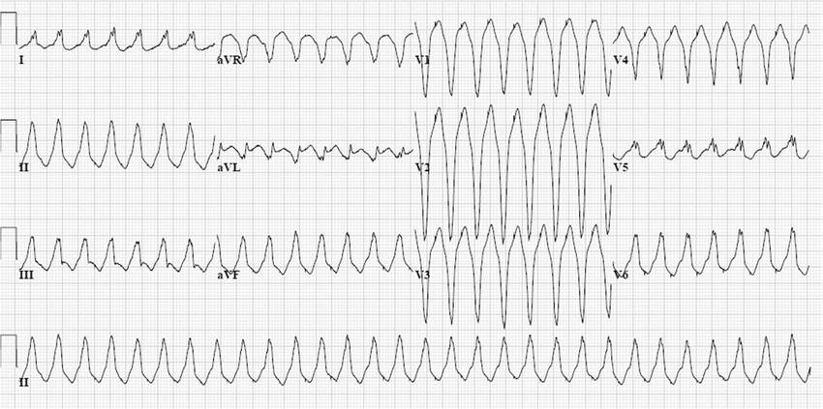
Ventricular tachycardia
Strong firing site inside the ventricles
Caused by Heart attacks, heart problems or surgery
Fast heart beats get up to 250 bpm
Seen on ECG as an abnormal QRS complex missing a P-wave

Slide 19
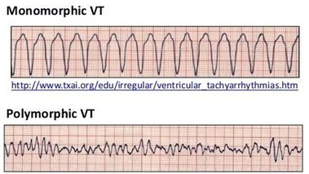
Monomorphic vs Polymrophic VT

Slide 20
I:5
Premature Ventricular Contractions

Slide 21
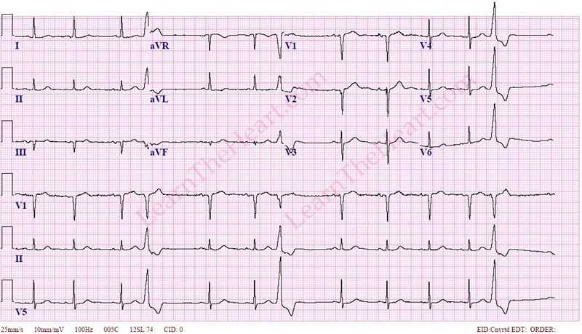
PVC
From the consumption of drugs, alcohol, medicaments or a scar in the heart tissue
Symptoms include skipped heartbeats and lightheadedness
Seen on ECG as an abnormal QRS complex missing a P-wave and skipped QRS complexes

Slide 22
I:6
Correlation

Slide 23
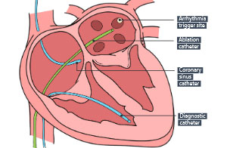
Cardiac ablation

Slide 24
Limitations
Understanding ECG is essential
Pace mapping could be used to locate the source of VT/PVC
Pace mapping uncertainties (tissue rigid & contracting, output, fascicular VT, scar, …)
Ablation is sometimes risky → Deep learning may help us find the right location of the abnormal electrical activity

Slide 25
Chapter II CLASSIFICATION OF QRS COMPLEXES

Slide 26
II:1
Introduction

Slide 27
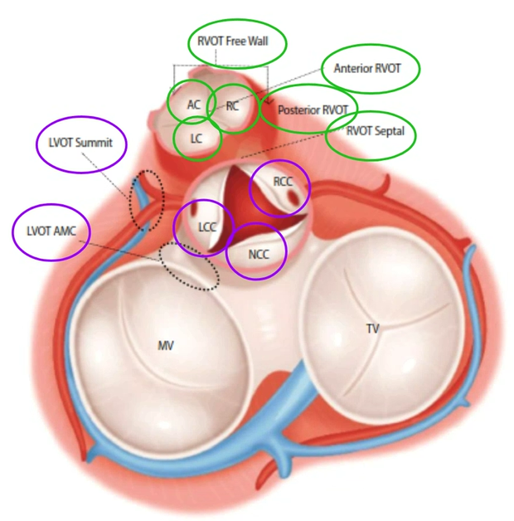
Simplifications
Binary Classification
Problems resulting from VTs & PVCs only
Manually selecting the right input

Slide 28
II:2
Data Sets

Slide 29
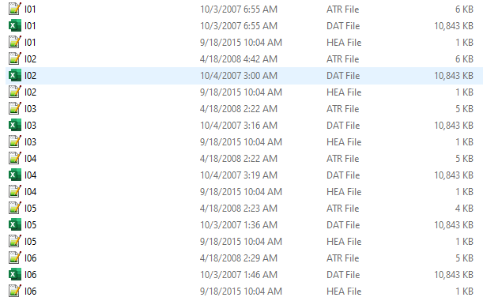
Polymorphic VT Data
F = 257 Hz
32 Patients
75 annotations
30 minutes each

Slide 30
II:3
Visualizations

Slide 31
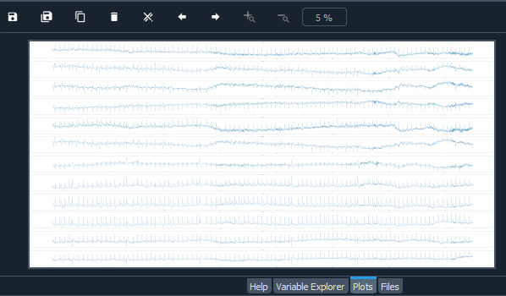
Polymorphic Visualization
The first 15000 sample of the 12-lead ECG of the first annotation IO1

Slide 32
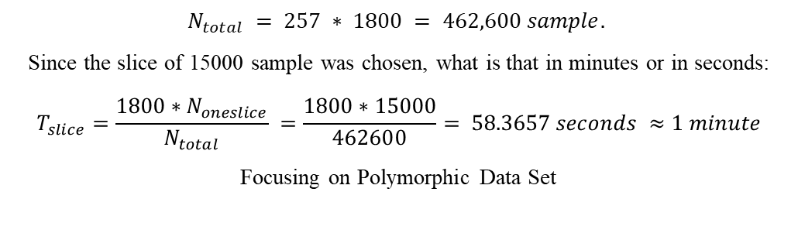
Polymorphic Data Sampling
$$N_{total} = 257 ∗ 1800 = 462,600 sample.$$
Since the slice of 15000 sample was chosen, what is that in minutes or in seconds:
$$T_{slice}=\frac{1800∗N_{oneslice}}{N_{total}} =\frac{1800∗15000}{462600}= 58.3657 seconds ≈1 minute$$
Focusing on Polymorphic Data Set

Slide 33
II:4
Cleaning & Choosing

Slide 34
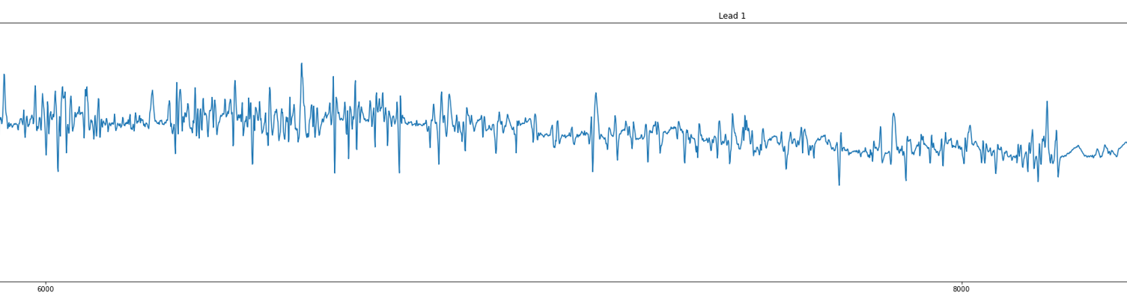
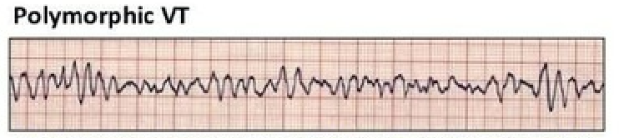
Choosing: Right Slices

Slide 35
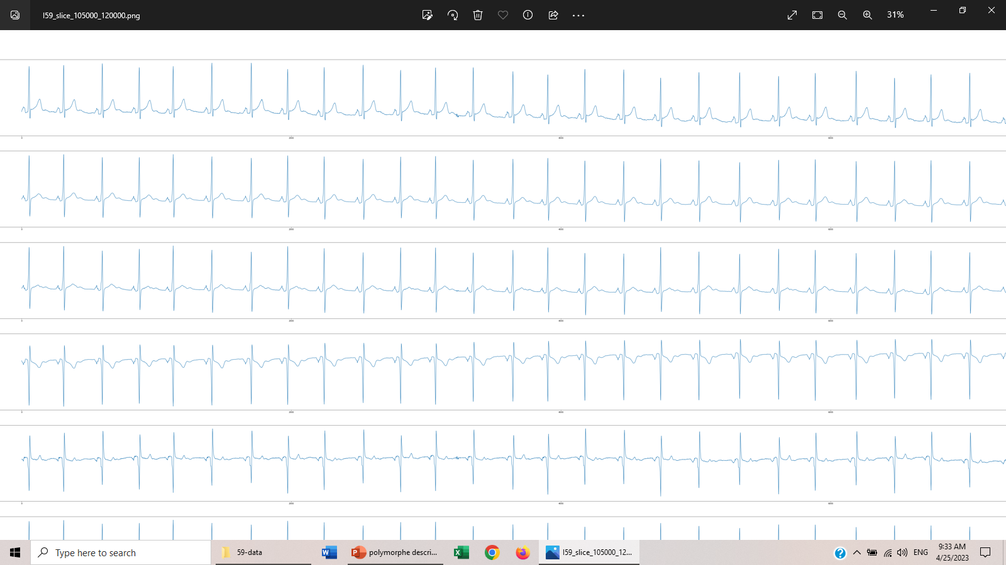
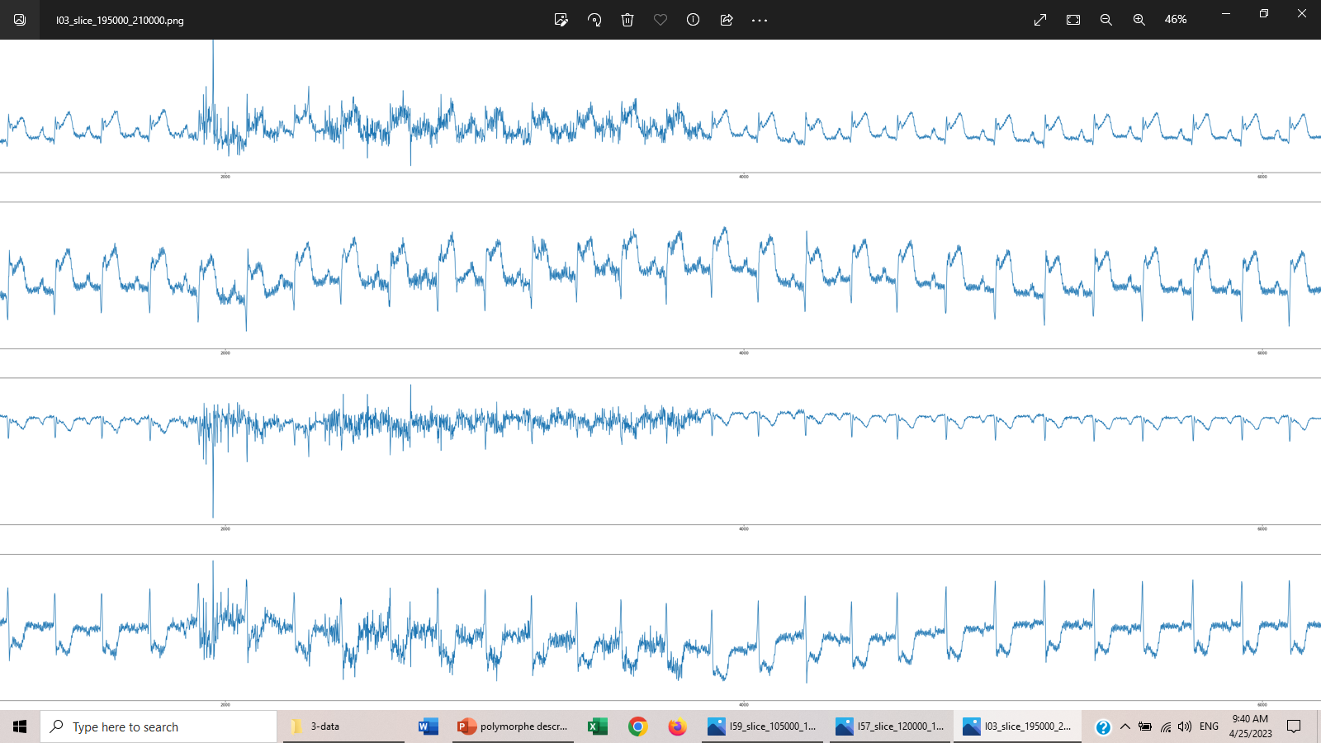
Choosing: Rejected Slices

Slide 36
Chosen Slices
Annotation | n slices | Annotation | n slices | Annotation | n slices | Annotation | n slices | Annotation | n slices
I01 | 10 | I16 | 0 | I31 | 8 | I46 | 13 | I61 | 0
I02 | 9 | I17 | 5 | I32 | 0 | I47 | 13 | I62 | 1
I03 | 0 | I18 | 10 | I33 | 0 | I48 | 18 | I63 | 0
I04 | 6 | I19 | 0 | I34 | 0 | I49 | 0 | I64 | 0
I05 | 3 | I20 | 11 | I35 | 15 | I50 | 13 | I65 | 3
I06 | 0 | I21 | 4 | I36 | 17 | I51 | 5 | I66 | 0
I07 | 0 | I22 | 5 | I37 | 0 | I52 | 0 | I67 | 19
I08 | 15 | I23 | 0 | I38 | 23 | I53 | 9 | I68 | 2
I09 | 2 | I24 | 0 | I39 | 4 | I54 | 11 | I69 | 1
I10 | 0 | I25 | 0 | I40 | 8 | I55 | 2 | I70 | 1
I11 | 0 | I26 | 7 | I41 | 0 | I56 | 0 | I71 | 0
I12 | 25 | I27 | 0 | I42 | 13 | I57 | 30 | I72 | 0
I13 | 0 | I28 | 0 | I43 | 0 | I58 | 11 | I73 | 0
I14 | 0 | I29 | 14 | I44 | 0 | I59 | 11 | I74 | 4
I15 | 4 | I30 | 18 | I45 | 0 | I60 | 3 | I75 | 0

Slide 37
II:5
Preprocessing

Slide 38
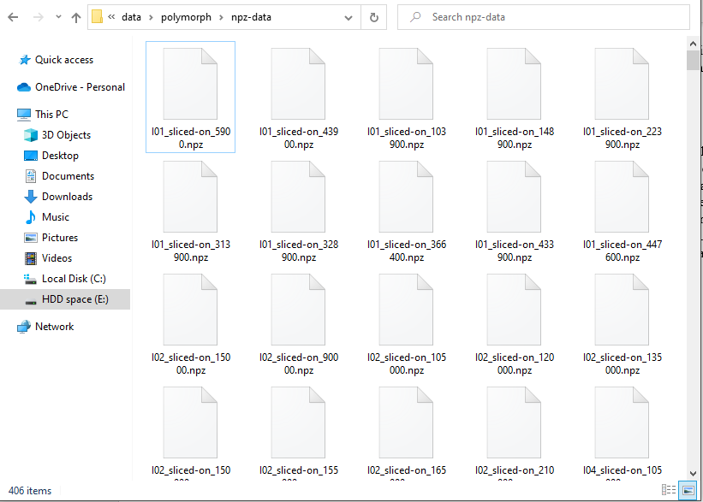
Preparation
Number of Slices

Slide 39
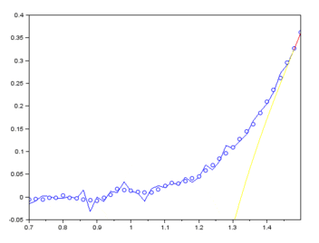
Filter: Savitzky–Golay filter
Select a window size (odd number) and polynomial degree.
Slide the window across the data points.
For each window position, fit a polynomial to the data points within the window using least squares regression.
Estimate the central point of the window based on the polynomial fit.
Repeat steps 3 and 4 for all data points.
The resulting smoothed data constitutes the output of the Savitzky-Golay filter.

Slide 40
II:6
Convolutional Neural Network

Slide 41

CNN Architecture

Slide 42
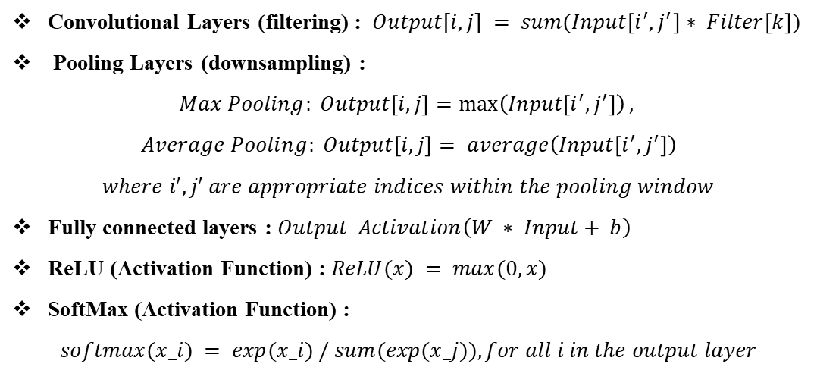
CNN main components (1)
Convolutional Layers (filtering) : $Output[i, j] = sum(Input\left[i^{′}, j^{′}\right]∗ Filter\left[k\right])$
Pooling Layers (downsampling) :
$$Max Pooling: Output\left[i, j\right]=\max\left(Input\left[i^{′}, j^{′}\right]\right),$$
$$Average Pooling: Output\left[i, j\right]= average\left(Input\left[i^{′}, j^{′}\right]\right)$$
$$where i′, j′ are appropriate indices within the pooling window$$
Fully connected layers : $Output Activation\left(W ∗ Input+ b\right)$
ReLU (Activation Function) : $ReLU(x) = max(0, x)$
SoftMax (Activation Function) :
$$softmax(x_i) = exp(x_i) / sum(exp(x_j)), for all i in the output layer$$

Slide 43
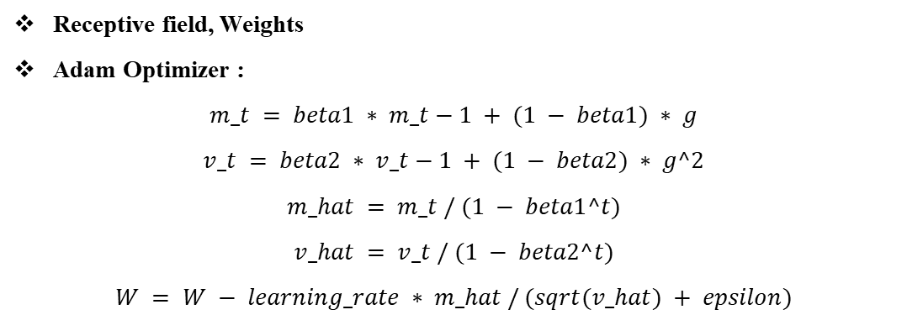
CNN main components (2)
Receptive field, Weights
Adam Optimizer :
$$m_t = beta1 ∗ m_t−1 + (1 − beta1) ∗ g$$
$$v_t = beta2 ∗ v_t−1 + (1 − beta2) ∗ g^2$$
$$m_hat = m_t / (1 − beta1^t)$$
$$v_hat = v_t / (1 − beta2^t)$$
$$W = W − learning_rate ∗ m_hat / (sqrt(v_hat) + epsilon)$$

Slide 44
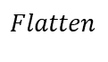
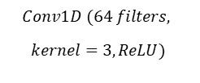
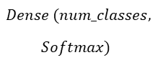
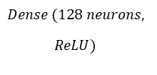
Applying the CNN on the preprocessed data set
𝐶𝑜𝑛𝑣1𝐷 (32 𝑓𝑖𝑙𝑡𝑒𝑟𝑠, 𝑘𝑒𝑟𝑛𝑒𝑙=3, 𝑅𝑒𝐿𝑈)
𝑀𝑎𝑥𝑃𝑜𝑜𝑙𝑖𝑛𝑔1𝐷 (𝑝𝑜𝑜𝑙_𝑠𝑖𝑧𝑒=2)
$$Conv1D (64 filters,$$
$$kernel=3, ReLU)$$
𝐼𝑛𝑝𝑢𝑡
𝑀𝑎𝑥𝑃𝑜𝑜𝑙𝑖𝑛𝑔1𝐷 (𝑝𝑜𝑜𝑙_𝑠𝑖𝑧𝑒=2)
$$Dense (num_classes,$$
$$Softmax)$$
$$Dense (128 neurons,$$
$$ReLU)$$
$$Flatten$$

Slide 45
II:7
Results & Conclusion

Slide 46
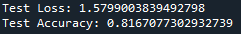
Result

Slide 47
Chapter III SIMULATION OF ECG SIGNALS

Slide 48
III:I
Simulation: Prediction Model

Slide 49
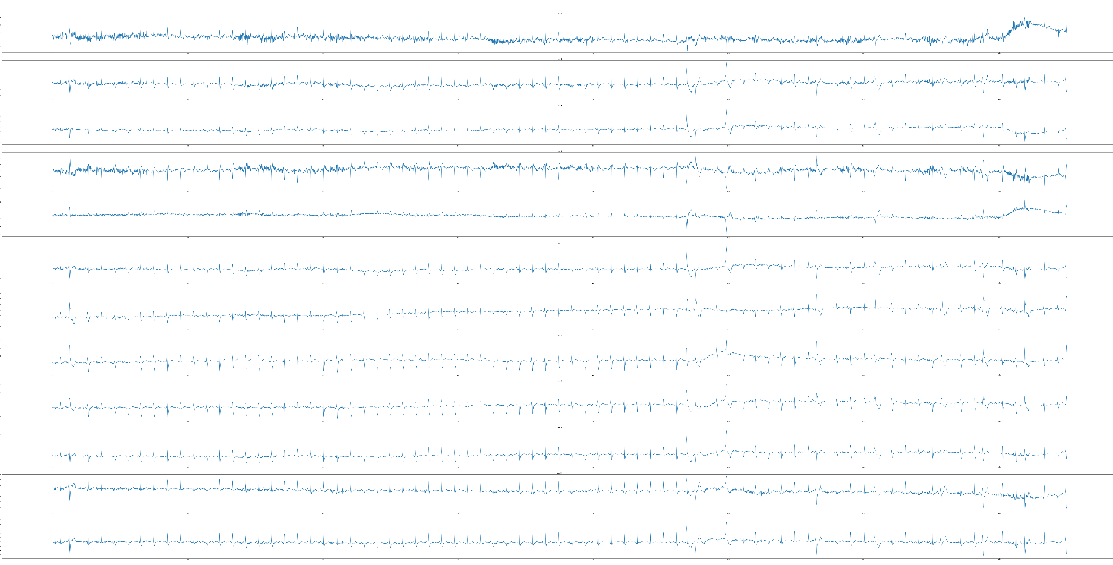
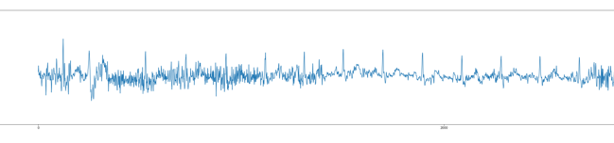
Simulation using the prediction of the model

Slide 50
III:2
Simulation: Mathematical Model

Slide 51
Mathematical Model (1)
• Sampling frequency of the ECG signal
• N total number of heartbeats to generate the signal
• Amplitude with or without noise addition
• Mean heart rate in bpm (beats per minute)
• Standard deviation heart rate
• Ratio of low-frequency to high-frequency components in the heart rate variability.
• Internal sampling frequency
• List of angles in degrees representing the waveform characteristics (P, Q, R, S, T)
• Amplitude parameters for the waveform components
• Shape parameters for the waveform components
• non-periodically of RR time series
• noise

Slide 52
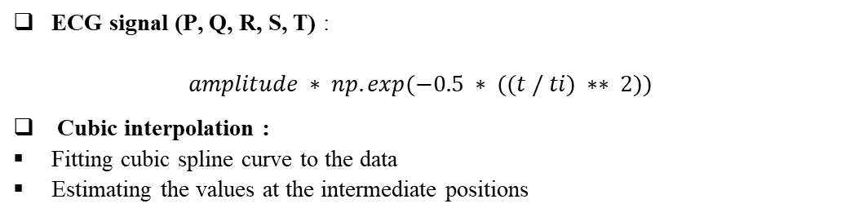
Mathematical Model (2)
ECG signal (P, Q, R, S, T) :
$$amplitude ∗ np.exp(−0.5 ∗ ((t / ti) ∗∗ 2))$$
Cubic interpolation :
Fitting cubic spline curve to the data
Estimating the values at the intermediate positions

Slide 53
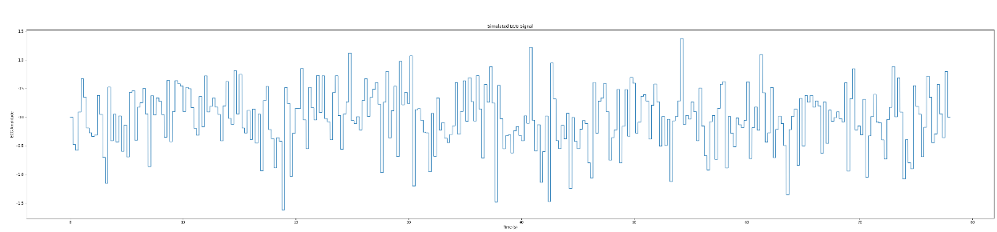
Mathematical Model (3)

Slide 54
III:3
Simulation: QRS Precise Model

Slide 55

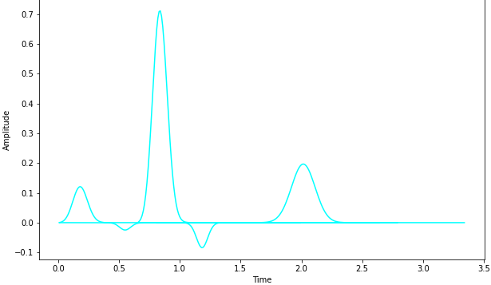
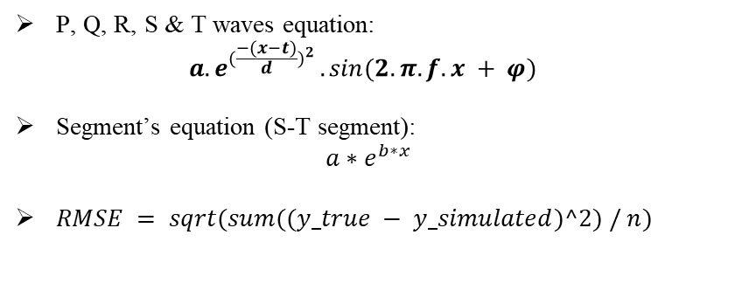
Precise Model
P, Q, R, S & T waves equation:
$${a.e}^{{(\frac{−(x−t)}{d})}^{2}}.sin{(2.π.f.x + φ)}$$
Segment’s equation (S-T segment):
$a∗e^{b∗x}$
$RMSE = sqrt(sum((y_true − y_simulated)^2) / n)$

Slide 56
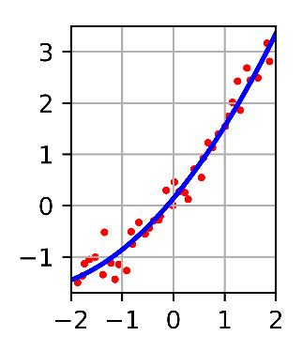
Least Mean Squares

Slide 57
wavelet transform(1)
Choose a wavelet function: Chosen db4 which is widely used in ECG signal processing
Choose a decomposition level, chose a high decomposition level to elevate and enhance the details of the decomposition
Use a high-pass filter and a low-pass filter to obtain coefficients at a current level
Threshold the coefficients obtained in the previous step by calculating the threshold value by the soft threshold technic
Compare the values to the threshold, if the value is below the threshold, it becomes 0, else it stays the same
Reconstruct the signal by using the coefficients and applying reverse wavelet transform
Repeat the process for every level

Slide 58
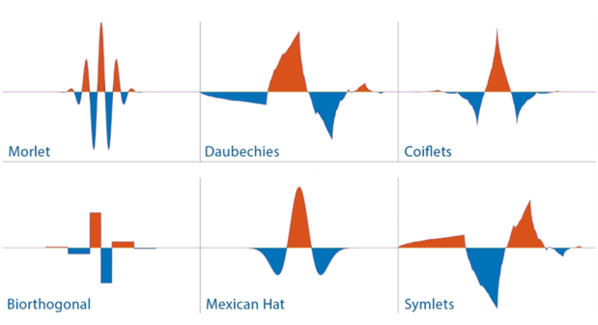
wavelet transform(2)

Slide 59
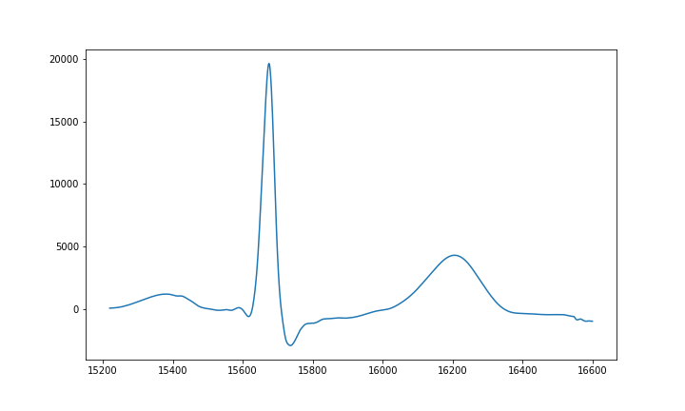
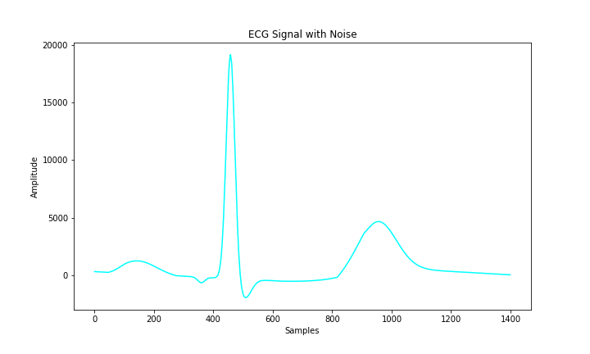
Resulted Simulation
4.3 %

Slide 60
CONCLUSION

Slide 61
THANK YOU

